Slide 1
Private Equity Finance Section 11 to 13
Yang Xi’s study notes
Apr 2022

Slide 2
Value Private Companies
Difficult to value private companies
No public market of their common stock ➔ no share price
Financials, including total common shares, may not be public knowledge
LP and GP need to know the value of their portfolio companies on a regular basis, usually quarterly
Basic ways of valuation
Comparable Valuation
Use a basket of public companies to closely resemble the private company ➔ complicated process
Consider size, sector, profitability, growth rate, etc
Price-to-Earnings, Price-to-Sales, Price-to-Book, Price-to-Free Cash Flow, EBITDA Multiple
Enterprise Multiple (EV-to-EBIDTA)
EV is the sum of market cap, value of debt, less minority interest and preferred shares (count as debt), deducted from cash and cash equivalents
Comparable Transactions
Identify comparable companies that have been acquired as reference
Not all transactions release price and valuation information

Slide 3
Value Private Companies
Basic ways of valuation
Discounted Cash Flow Analysis (DCF)
Make assumptions about the future financial performance for the coming 5-10 years
Growth in revenues, operating costs, taxes, working capital requirements, removal of personal expenses / owner salaries / dividends, etc
Calculate free cash flow from the business after working capital and capital expenditure
Ignore interest payments as this is an unleveraged calculation
Calculate cash flow available to stockholders
Then calculate peer group’s average beta, tax rates, debt to equity ratios
Then calculate Weighted Average Cost of Capital (WACC) using the Capital Asset Pricing Model (CAPM) to value the cost of equity
As private companies’ stock is not liquid – a higher risk – CAPM uses a multiplier (beta) to reflect the higher cost of private company equity
Choosing this beta is difficult and it has a significant impact on the valuation
Also estimate cost of debt from the company’s credit history and interest rates paying
Then weight the cost of equity and debt to match the gearing in the company
Create an integrated DCF model
Discount future cash flows (5-10 years) to the present using the WACC as the discount rate
Warning: the valuation is very sensitive to the discount rate
Calculate a terminal value for the remainder of future cash flows, and discount it back to the present

Slide 4
Value Private Companies
Basic ways of valuation
EBITDA Multiples
PE firms may use EBITDA multiples to simplify the process. It also makes price negotiation simpler.
Chose of the multiple is critical, but the PE firm control this based on their “previous transactions”
Hard for the sellers to argue against this particular number
The reporting accountants will review the earnings quality, and come up with an “adjusted EBITDA” for PE firm to apply their chosen multiple.
Typically adjusted down in favor of PE firms; while the sellers need to push back against.

Slide 5
What is EBITDA?
earnings before Interest, Tax, Depreciation and Amortization (ITDA)
Essentially, EBITDA is Net Income with ITDA added back
Enable comparative profitability between companies
Eliminates the effects of financing and accounting decisions
Typically used for valuation ratios
A proxy for the company’s ability to service debt in LBO
Depreciation and Amortization are not cash items
Interest and tax are cash items. Interest is “tax sheltered”
Not a good metric for evaluating Cash Flow
Does not help to measure working capital
Example of Company X
Revenue = $200m, Product Cost = $80m, Operating Ex = $40m
Depreciation and Amortization Ex = $20m ➔ Operating Profit = 200-80-40-20 = $60m
Interest Ex = $10m ➔ Earnings before Taxes = 60-10 = $50m
20% Tax Rate ➔ Net Income = 50-10 = $40m
EBITDA = 40+10+10+20 = $80m

Slide 6
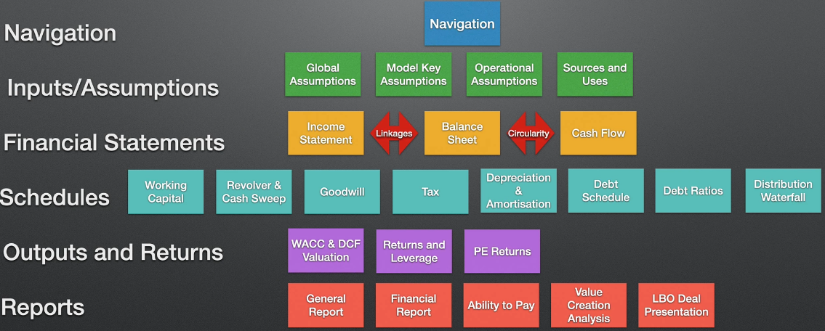
Introduction to LBO Modelling
LBO Modelling is a critical part of an LBO process
Normally done by the PE firm
Can also be done by the Investment Bankers if they are trying to get a deal funded
In essence, and LBO model has six levels

Slide 7
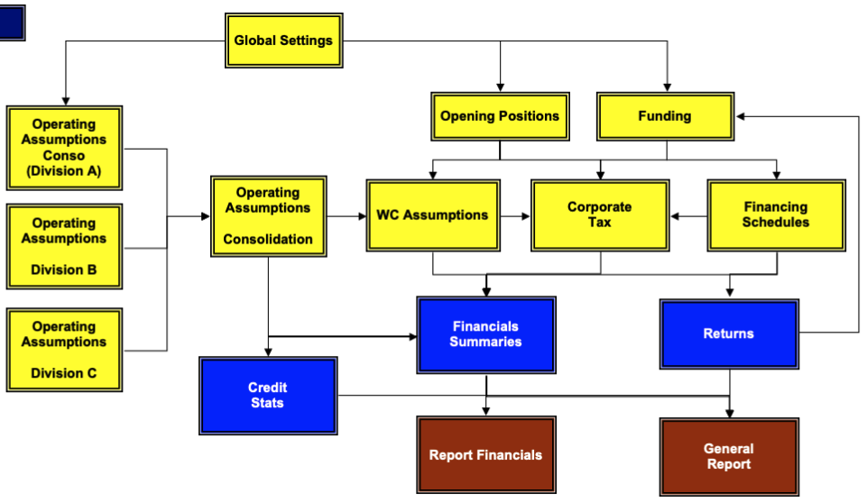
Navigation – Overview of an LBO Model’s Structure
Yellow boxes (sheets): inputs and calculations
Blue boxes (sheets): outputs
Brown boxes (sheets): presentation and report
Start from the Global Settings
The core is to have an integrated IS, BS & CF model, and build everything around it. It will also be presented in the financial analysis (in blue boxes)

Slide 8
Navigation – Overview of an LBO Model’s Structure
Opening Positions: post deal income statement and balance sheet for the deal
Funding: all funding inputs
Make Working Capital (WC) assumptions from Operating Assumptions and Opening Positions – critical to the forecasting of the balance sheet
Financing Schedule from the Opening Positions and Funding Sheet
Then feed into the Tax sheet

Slide 9
Document Sources
In a Private Company transaction, access to management is critical
Public information is very limited – no substitute for management input
Public Companies
Historic Financials – a basic line is to use 3-year historic financials
Analyst presentations: presentations made by management, which frequently contain detailed information on the business, including the managements' public view (often optimistic) of the future
Earnings Calls Transcripts: frequently contain otherwise unpublished nuggets of information, often in response to questions from analysts
Equity Research
Filings: 10K
Merge Documentation; any SEC fillings or Stock Exchange circulars
Any documentation with Risk Factors
Investor Relations webpages of the company

Slide 10
More..
This are lots of details in processes and computations…
I will skip it for now…

Slide 11
Assessing Risk in PE Investment
Recall that
PE uses leverage to magnify returns
PE actively manage their investments to improve returns
PE aim to buy-low-sell-high (benefit from arbitrage)
Active management (alpha) and external market conditions (beta) also contribute to growth
Risk
High entry barrier (capital commitment) – usually at least $250K
Long commitment – normally 10 years – little liquidity
Sell in secondary transaction usually result in a discount
Market risk – adverse conditions, poor management, etc
Default risk
The same points can also be applied to VC, but more risky

Slide 12
Management Equity in LBO
It is important to incentivize the senior management in buyout
Rollover (usually >50%) their previous stake to the buyout
Sweet Equity – a separate option plan with significant capital gain, about 20-30 times multiplier
Sweet Equity only pays out if PE firms equity also makes high return
There may be specified return hurdle rates – only vest unital GP has achieved hurdle return
Totally usually up to 20% distributed among the C-Suite
Shareholder Loan – usually about 8% - 12% coupon

